Slide 1



Data Science Methods for Cutting-edge Tech
Knowledge and solutions for a changing world
Advancing data-intensive discovery in all fields
Be boundless
UW DIRECT
(Métodos de ciencia de datos para tecnología de punta)
https://uwdirect.github.io
Chad Curtis (ccurtis7)
Chemical Engineering
David A. C. Beck (dacb)
Chemical Engineering & eScience Institute

Slide 2
Review
Questions from the AM?
How many finished the notebook?
How many got stuck on interpolating the CDF and inverse CDF?

Slide 3
Today…
Error bars
Significance
p-values
Hypothesis testing

Slide 4
Error bars
What is an error bar?

Slide 5
Error bars
What is an error bar?
How do we interpret these error bars?

Slide 6
Error bars
What is an error bar?
This is better, right? We know the units.

Slide 7
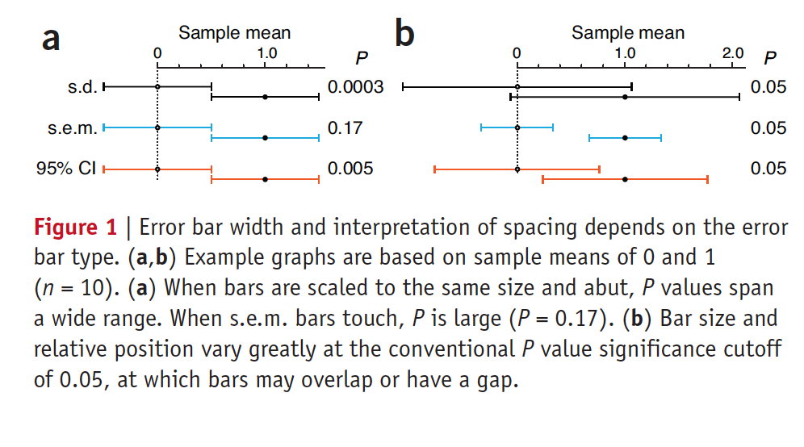
Error bars
What is an error bar?
What does an error bar actually measure?
Two samples of size n
One has apparent mean of 0 the other of 1.0
Let’s say we do a statistical test; Which of the below are significantly different?
(assume significance is called at p < 0.05, more on this later)
Error bars. Points of significance. Nature, 2013.

Slide 8
Error bars
What is an error bar?
What does an error bar actually measure?
Two samples of size n
One has apparent mean of 0, the other of 10
WHAT THE HECK!!?!?!?
Error bars. Points of significance. Nature, 2013.

Slide 9
Error bars
What is an error bar?
What does an error bar actually measure?
Two samples of size n
One has apparent mean of 0, the other of 10
Ohhhh….
Error bars. Points of significance. Nature, 2013.

Slide 10
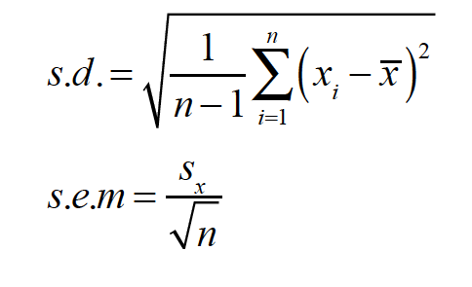
Error bars
What is an error bar?
What does an error bar actually measure?
Two samples of size n
One has apparent mean of 0, the other of 10
s.d. we are already familiar with (standard deviation)
s.e.m. is standard error of the mean
95% CI is the interval that will contain the mean 95% / time
Error bars. Points of significance. Nature, 2013.
Notes:
Standard deviation informs us of the spread of the population. Useful as predictors of new samples.
SEM bars reflect the uncertainty in the mean, and its dependency on sample size. The idea that if SEM bars don’t overlap, you have statistical significance is untrue.
95% CIS indicate reliability of measurement.
If you have a large sample (n>15), then 95% CIS are 2x SEM.

Slide 11
Error bars
What is an error bar?
Error bars. Points of significance. Nature, 2013.

Slide 12
Error bars
What is an error bar?
Some sub-domains of science and engineering have community standards about which type of error bar to use.
Know you audience!
Nature Methods papersin 2012: The type of error bars was nearly evenly split between s.d. and s.e.m. bars (45% versus 49%, respectively). In 5% of cases the error bar type was not specified in the legend. In only 1 case was 95% CI used.
Error bars. Points of significance. Nature, 2013.

Slide 13
Error bars
What is an error bar?
s.d. error bars tell us about the the spread of the population, i.e. variation in data, not error in measurement
s.e.m. error bars tell us about uncertainty in the mean and its dependency on sample size, n

Slide 14
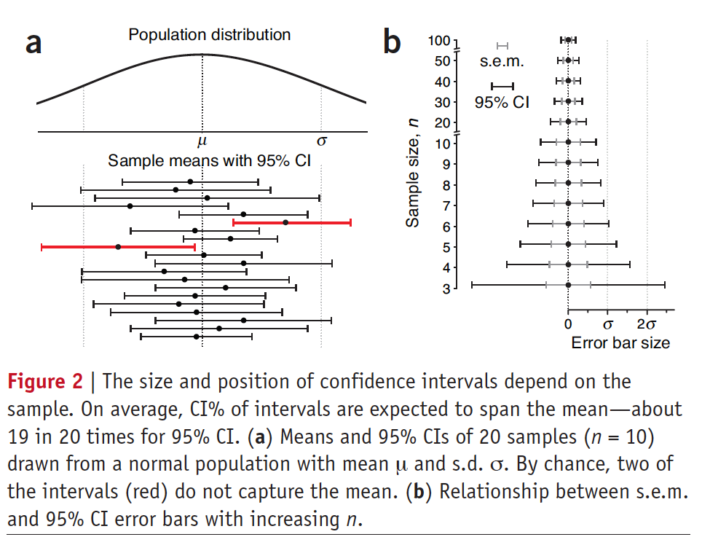
Error bars
What is an error bar?
Confidence interval error bars tell us about the reliability of the measurement
Error bars. Points of significance. Nature, 2013.

Slide 15
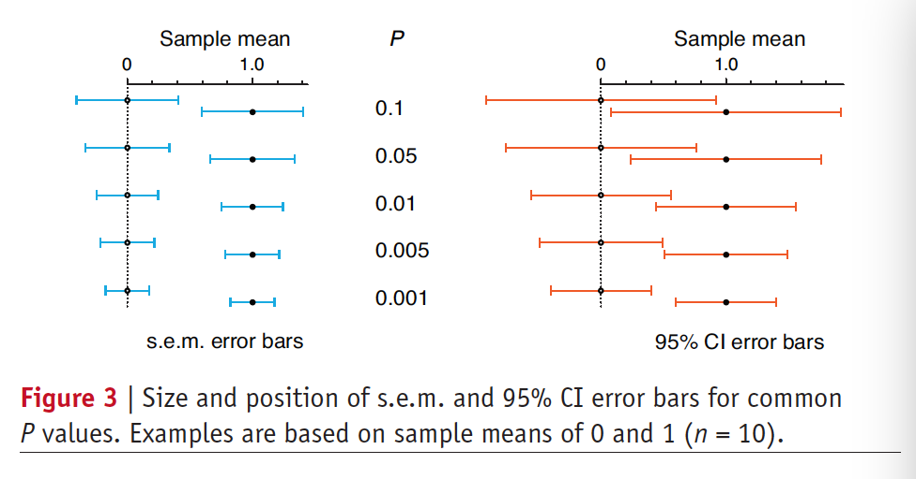
Error bars
What is an error bar?
Relationship between s.e.m., 95% CI, and p-value
Error bars. Points of significance. Nature, 2013.

Slide 16
Error bars
What is an error bar?
Know your error bar type!
Be clear about your error bar type in figure legend
Don’t choose an error bar type to ”make things look significant!”
Error bars. Points of significance. Nature, 2013.

Slide 17
Error bars
What is an error bar?
Be wary of error bars for small sample sizes
They are not robust estimates (as we have seen last lecture)
Error bars. Points of significance. Nature, 2013.

Slide 18
Significance
What is statistical significance?

Slide 19
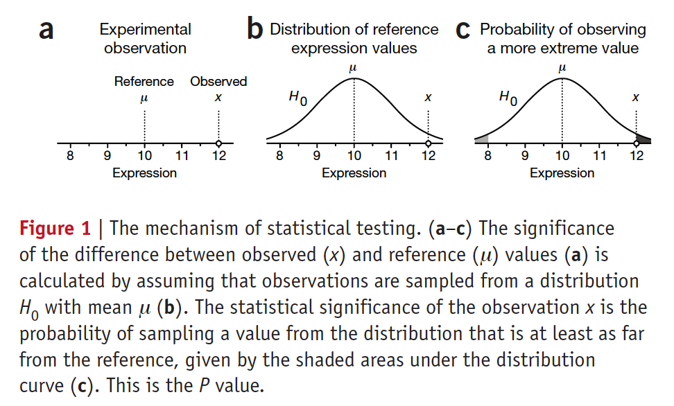
Significance
Let’s walk through an example
Significance, p-values, t-tests. Points of significance. Nature, 2013.

Slide 20
Significance
Let’s walk through an example
Significance, p-values, t-tests. Points of significance. Nature, 2013.

Slide 21
Significance
Let’s walk through an example
Significance, p-values, t-tests. Points of significance. Nature, 2013.

Slide 22
Significance
Let’s walk through an example
Significance, p-values, t-tests. Points of significance. Nature, 2013.

Slide 23
Significance
Statistical significance
What is the likelihood the difference between our observation and the reference is due to random chance?
Significance, p-values, t-tests. Points of significance. Nature, 2013.

Slide 24
Significance
Statistical significance
The reference 𝜇 is characterized by a distribution
In significance testing we call it the null distribution
Significance, p-values, t-tests. Points of significance. Nature, 2013.

Slide 25
Significance
Statistical significance
The reference 𝜇 is characterized by a distribution
Locate our observation in the null distribution
Significance, p-values, t-tests. Points of significance. Nature, 2013.

Slide 26
Significance
Statistical significance
The reference 𝜇 is characterized by a distribution
We can ask how likely is it that our observation was drawn from the null distribution
What is one transformation of H₀(x) that we can use to test this?
Significance, p-values, t-tests. Points of significance. Nature, 2013.

Slide 27
p-values
Statistical significance
The p-value is the probability of sampling another observation from H₀ that is as far or farther away
Significance, p-values, t-tests. Points of significance. Nature, 2013.

Slide 28
p-values
The p-values do not:
Measure the probability a hypothesis is true
Measure the probability your data were produced by random chance
Tell you anything about effect size
Tell you anything about the importance of a result
Highlights from the ASA statement on p-values
Notes:
Data at least as extreme as theta-hat would be seen in proportion p of replicate studies, if theta-not were the true value of theta.

Slide 29
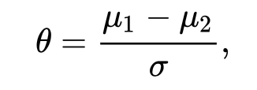
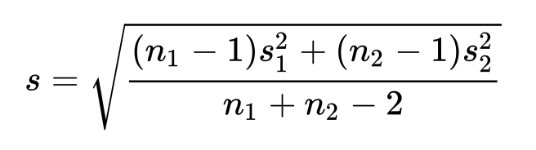
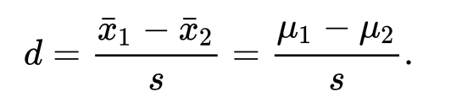
Power (prelude)
What is effect size?
We’ve seen that sample parameter estimates improve with n (last week’s class)
Similarly, our ability to detect small effect sizes improves with increasing n₁ and n₂

Slide 30
p-values
The p-values do tell you that given our belief in the null hypothesis (H₀) a low probability event has occurred when p is low.
“The degree of improbability is evidence against H0 and supports the alternative hypothesis that the sample actually comes from a population whose mean is different than 𝜇.“
Significance, p-values, t-tests. Points of significance. Nature, 2013.

Slide 31
p-values
The p-values do tell you that given our belief in the null hypothesis (H₀) a low probability event has occurred when p is low.
“Data at least as extreme as x would be seen in proportion p of replicate studies, if μ were the true population mean.”
Significance, p-values, t-tests. Points of significance. Nature, 2013.

Slide 32
p-values
We call a result significant if the p-value is below our significance threshold or α
Common α’s are what?

Slide 33
Hypothesis testing
How do we know the nature of H₀?
We can take 𝜇 from previous measurements.
How do we estimate population 𝜎?

Slide 34
Hypothesis testing
How do we know the nature of H₀?
We make one really important assumption...
The population standard deviation can be estimated from the sample s.d.
Is this true?

Slide 35
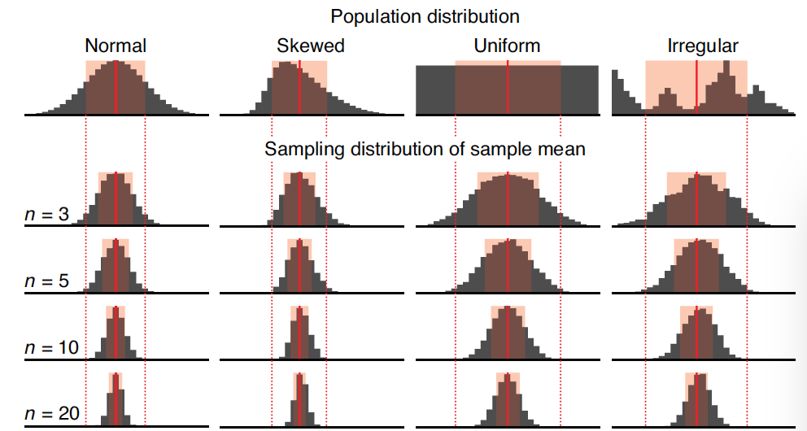
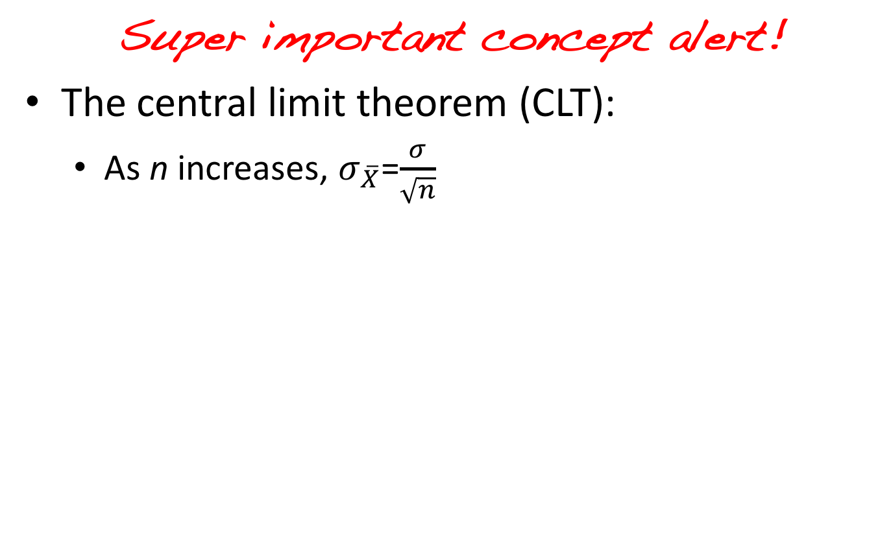
Statistics
Super important concept alert!
The central limit theorem (CLT):
As n increases, $σ_{\overline{X}}$=$\frac{σ}{\sqrt{n}}$
Nature, 2013. Importance of being uncertain.

Slide 36
Significance
How do we know the nature of H₀?
We make one really important assumption...
The population standard deviation can be estimated from the sample s.d.
Is this true?
Yes, but gets better for large n.

Slide 37
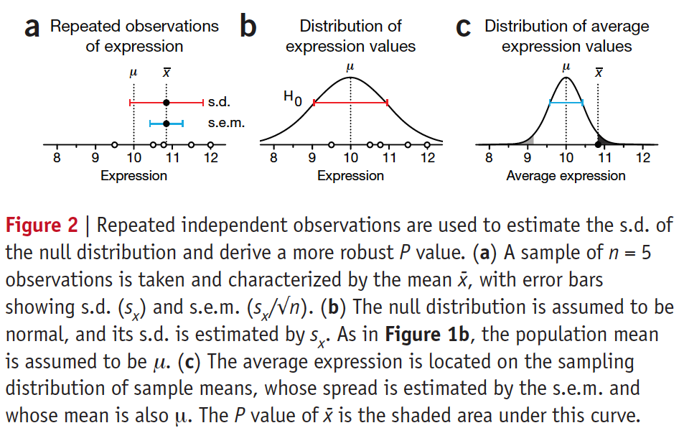
Hypothesis testing
How do we know the nature of H₀?
Significance, p-values, t-tests. Points of significance. Nature, 2013.

Slide 38
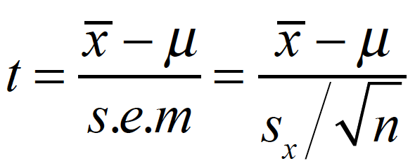
Hypothesis testing
But how we get a p-value without doing all that work for any given measurement?
The test statistic! For normal distributions, this is the t-statistic (thus the t-test).

Slide 39
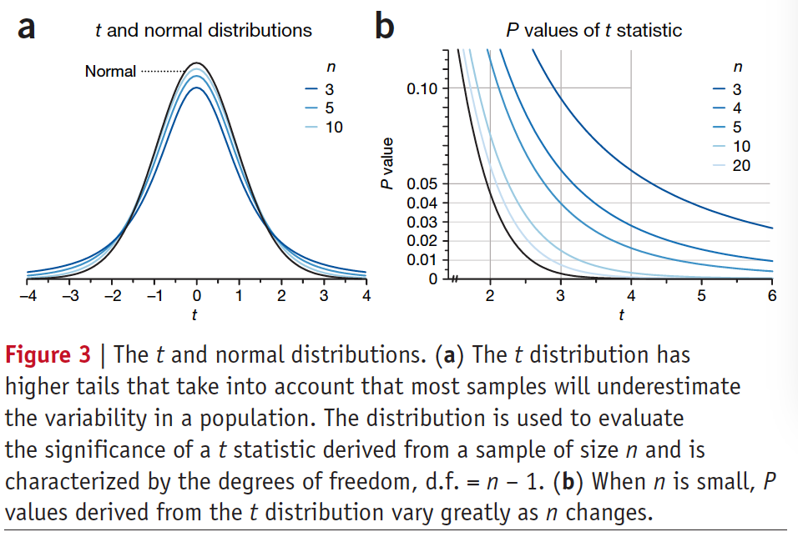
Hypothesis testing
But how we get a p-value without doing all that work for any given measurement?
The t-statistic follows its own distribution
Similar to normal
Different to account for the fact that for most n, the sample derived variance is an under-estimate of the H₀ variance
Evidence by figure 3a
Significance, p-values, t-tests. Points of significance. Nature, 2013.

Slide 40
Hypothesis testing
Practically, we take our value of the t-statistic, use a lookup table to get the associated p-value, e.g. scipy.stats.ttest_1samp
Significance, p-values, t-tests. Points of significance. Nature, 2013.

Slide 41
Hypothesis testing
This was all under the assumption that our data are normally distributed.
Our H₀ is based on a reference distribution
For each distribution, there is a specific test-statistic and methodology for significance testing, e.g.
https://en.wikipedia.org/wiki/Binomial_test

Slide 42
Hypothesis testing
One sample test
Comparing to idealized reference
Two sample test
Robustly compare two samples drawn from different conditions (e.g.)

Slide 43
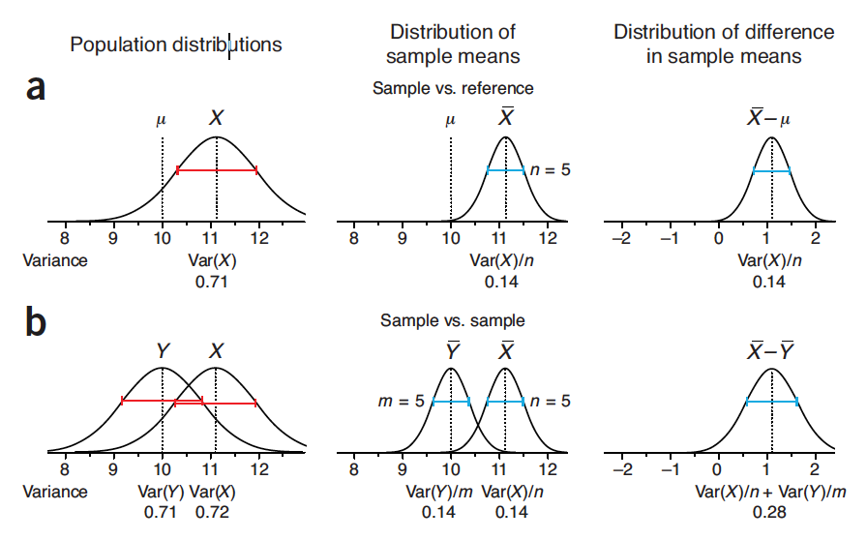
Hypothesis testing
Two sample test
Robustly compare two samples drawn from different conditions (e.g.)
One sample
Two sample

Slide 44
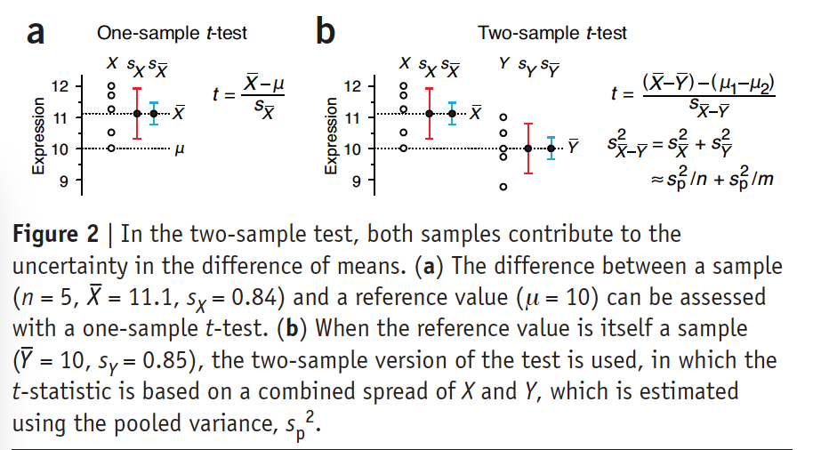
Hypothesis testing
Two sample test
scipy.stats.ttest_ind
equal_var=False

Slide 45
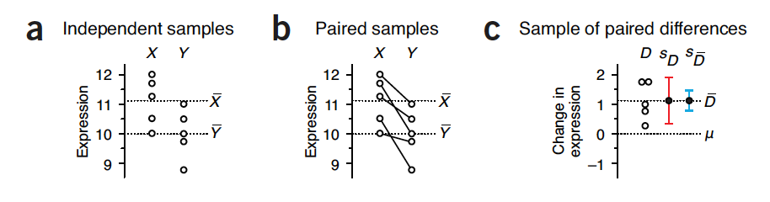
Hypothesis testing
The final piece, paired test
What happens if we have the same sample but before and after treatment?
Compute the differences D_{XY} and perform a one sample t-test on D
Why is this cool?
Notes:
By constructing a
sample of differences in expression (D; Fig. 3c), we reduce the test
to a one-sample t-test in which the sole source of uncertainty is
the spread in differences. The spread within X and Y has been factored
out of the analysis, making the test of expression difference
more sensitive.

Slide 46
Hypothesis testing
Parametric tests
Make assumptions about the parameters and form of the population distributions from which our data are being sampled.
Is this OK?

Slide 47
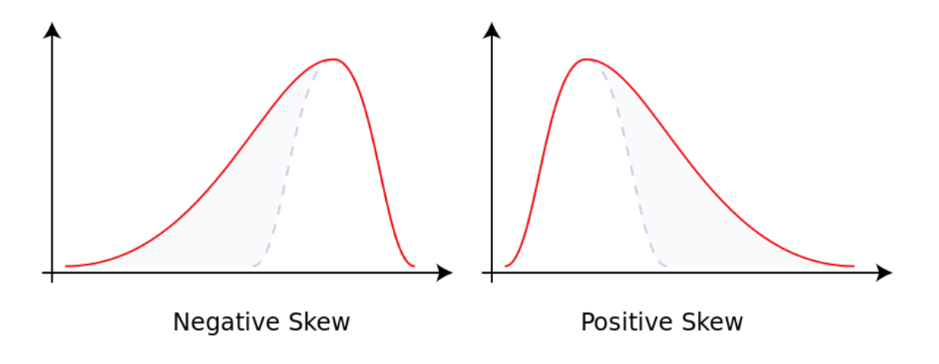
Hypothesis testing
Non-parametric tests
“distribution-free” tests
Make fewer if any assumptions about the nature of the data
Can be useful if:
Your data deviate from canonical distributions, e.g. skew
Your data are better described by the median (recall...)
You have small sample sizes
Your data are ranked or ordinal in nature

Slide 48
Hypothesis testing
Non-parametric tests
Lots of these exist
Beyond the scope of lecture, but you have the basis to learn them (riiiiiight???)
Complementary parametric tests of means and non-parametric tests of medians
Parametric test of means | Non-parametric test of medians
1-sample t-test | 1-sample Sign, 1-sample Wilcoxon
2-sample t-test | Mann-Whitney test

Slide 49
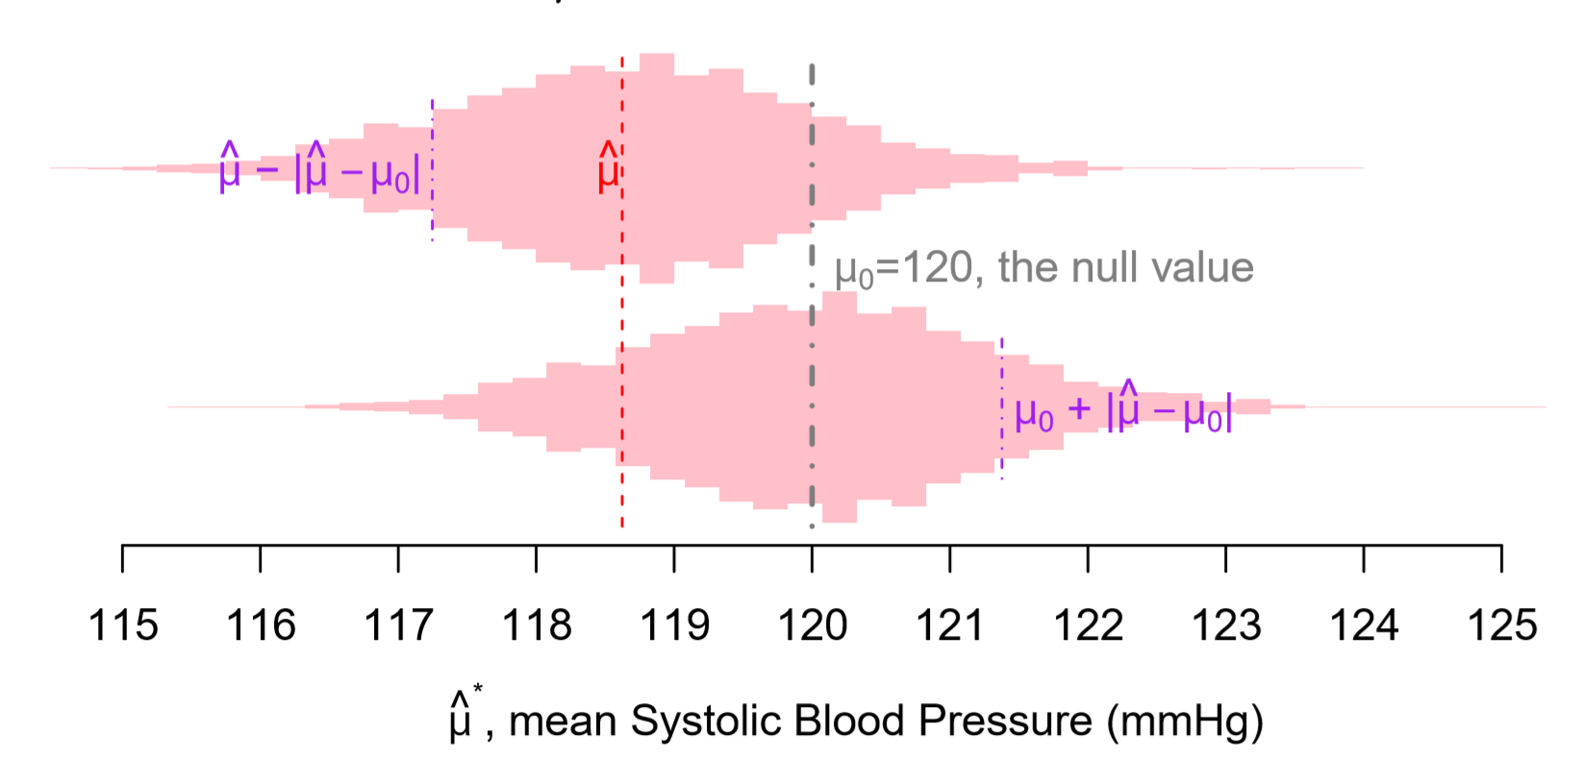
Bootstrapping
AND you can use bootstrapping to get estimates of p-values t-test-free!

Slide 50
One final note…
If you test a lot of hypothesis on the same data with a fixed α level, you will, through random chance find significant results
Multiple hypothesis testing problem
Bonferroni, q-values, local false discovery rate
Can be done intentionally or not: p-hacking
Testing hypotheses until you find something significant

Slide 51
One final note…
http://tylervigen.com/spurious-correlations

Slide 52
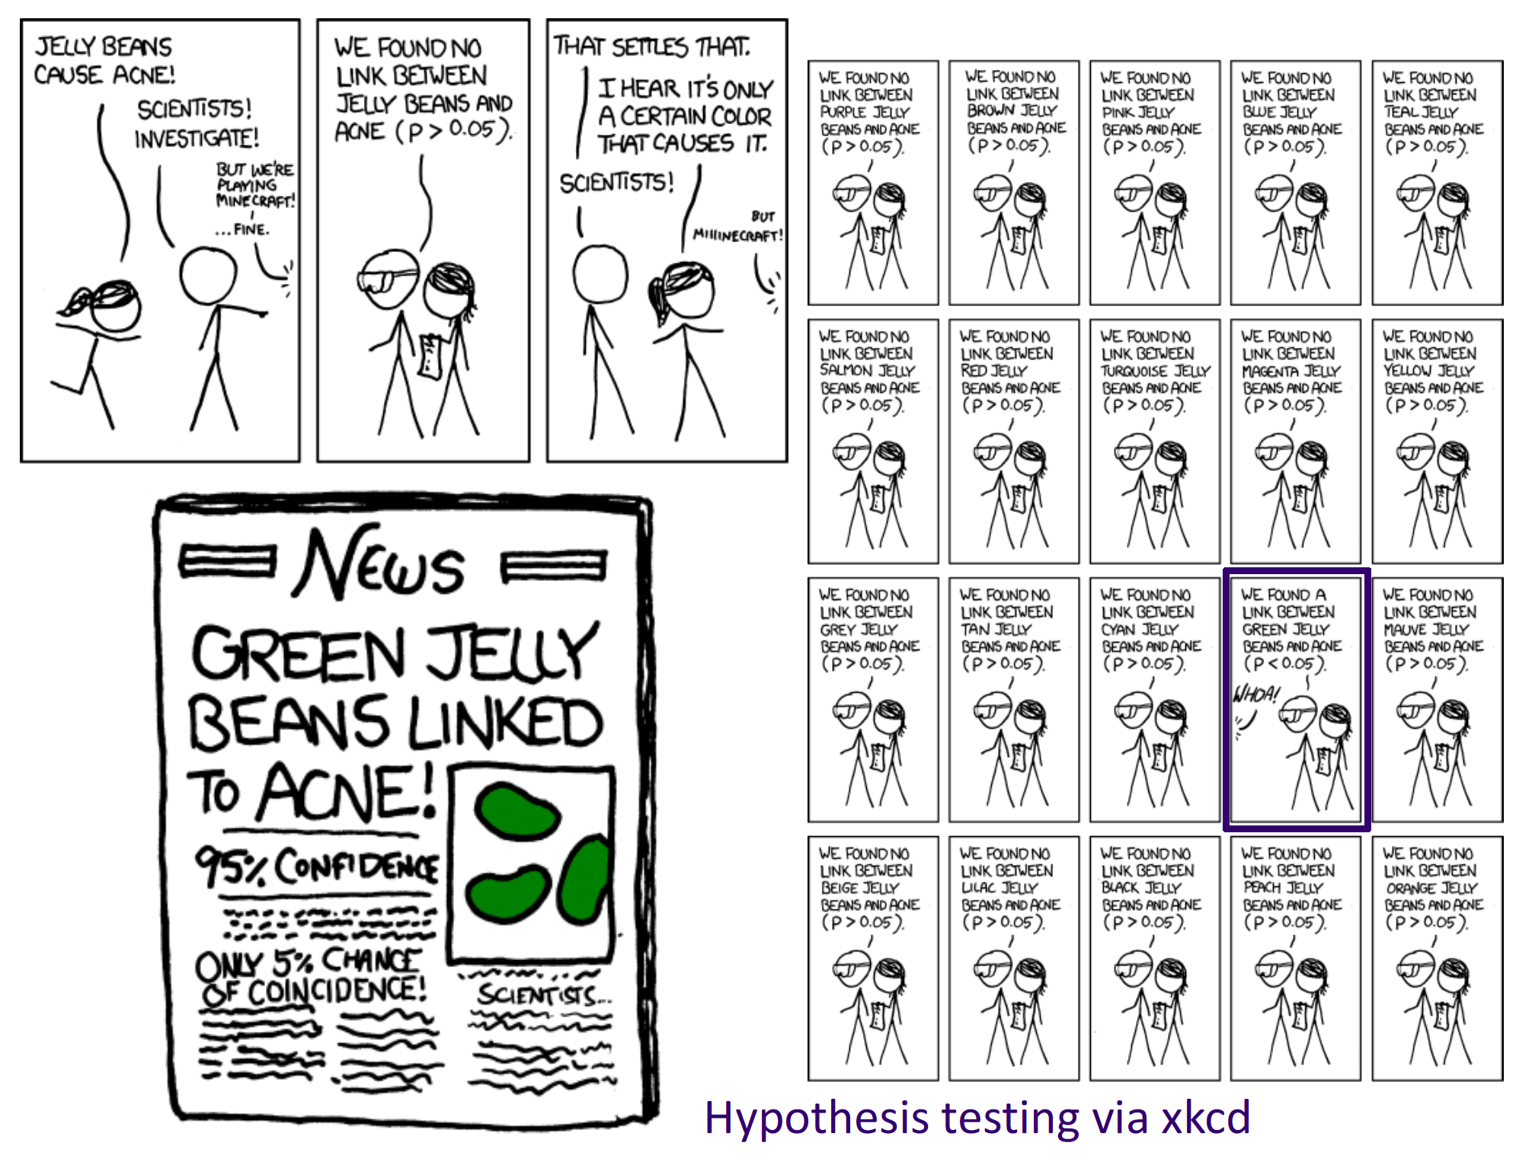
One final note…

Slide 53
Hacky hack?
If we have time, there is a notebook…
Pick a partner, don’t be afraid to mix it up, and work through the notebook

